Slide 1
GO COLLEGE
Group-25
PRESENTED BY:
MITHRA KONDAMUDI
BALA KEERTHIMAI AKURATHI
ROSHNI GUNTUPALLI
YOGITHA RONDLA
SINDHUJA ELLANKI
Clients:
We ourselves acting as our clients

Slide 2
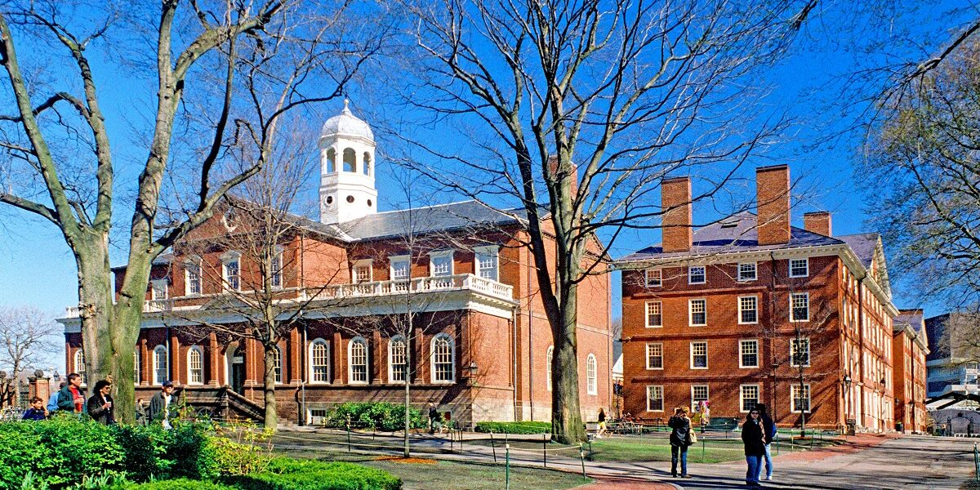
PROBLEM DOMAIN
Navigating the campus poses a common challenge for incoming freshmen, hindering their seamless integration into university life.
This initiative aims to empower freshmen with the expertise needed to confidently locate the buildings and navigate routes within the campus, ensuring a smoother and more enriching transition to campus life.

Slide 3
SYSTEM CONCEPT STATEMENT
“Go College” System
The application empowers students to choose the fastest and most accurate routes to their classrooms based on real-time data.
Students can customize their preferences, such as shortest route or least crowded path, to tailor the navigation experience to their needs.
Recognizing that circumstances may change, the application always suggests alternative routes in the event that if the recommended path is inaccessible or inconvenient.
The application provides detailed information about campus buildings, including classrooms, lecture halls, and other key facilities.
The design prioritizes simplicity, allowing users to quickly plan their journeys and select precise paths without unnecessary complexity.

Slide 4
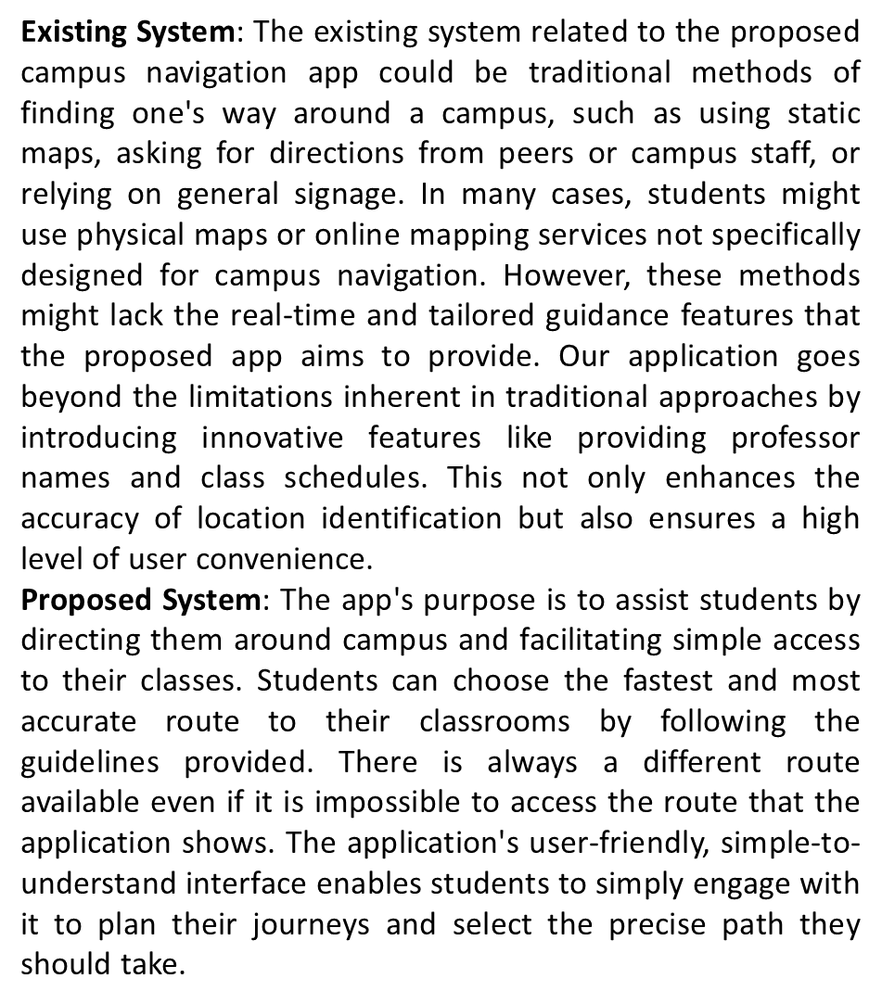
TECHNICAL SUMMARY

Slide 5
TARGET INDIVIDUALS & METHODOLOGY
Throughout the ideation and development process of the Go College app, we kept the requirements and preferences of the students front and center.
We were able to learn about the difficulties students encounter and the aspects they value most thanks to the open dialogues that took place throughout feedback sessions and questionnaires. Forming an accurate picture of the campus layout and emergency procedures required close collaboration with university administrators.
During the design phase, the goal was to develop an interface that would make route planning easier and feel more like a helpful companion. By guaranteeing that the app displays the most recent class schedules, real-time data integration provides a layer of trust.
Making the software adaptive and responsive requires extensive testing and continual improvements based on user input.We want to present the app as more than just a navigation tool through educational activities.
We want it to be seen as a dependable companion that helps students navigate campus life confidently and efficiently, which will enhance their overall happiness and well-being.In the app, we have taken measures to ensure the confidentiality of user information.

Slide 6
INTERACTION REQUIREMENTS
Customers who already have accounts can enter their login information to access this application.
This will allow freshmen students to track alternative routes if the recommended path is inaccessible.
Students are able to track the routes to their destination by giving their professor’s name and class timings.
Set up a new account
Route Tracking (Guest)
Existing customer
Route tracking (Students)
Alternate route tracking
Users will be able to do this to make a new account with their student credentials to know the routes.
Guests are able to navigate to their routes by just providing their destination building name.

Slide 7







INTERACTION REQUIREMENTS
Student with UC credentials:
The one who has UC credentials will login in the application to reach the destination.
Guest login :
The one who is new to the university will directly be redirected without credentials because they are the temporary logins.
Monitoring of student:
After receiving the information which includes class timings and professor details from the freshman, the location is analyzed and final destination is sent to them.
Readings of student:
A Graphical Map which displays the destination they desired to go.
Monitoring of guest:
Based on the Inputs given by the user, destination location is displayed.
Reports :
A clear track will be given to the users after their input.
We then collaborated to pinpoint the primary areas of concern that emerged throughout our interviews after obtaining our documentation and simplifying the majority of the demands. After gathering the areas where the students had said it would be beneficial to have interactions or considering those areas, we reduced the list down to the following interaction needs.

Slide 8
PERSONA
Personality traits for the Go College application are derived from initial conversations with individuals and experiences of freshmen facing common challenges. Two primary user groups, college students and visitors, were identified through interviews, leading to the creation of user scenarios and personas to cater to specific needs and requirements..
Students(Freshmen)
Visitors
Murali Krishna, a 22-year-old freshman and master's student, faced the challenge of navigating different buildings for his classes. Using our program, he swiftly identified optimal routes, ensuring punctual attendance. The program's accurate information saved his valuable time, eliminating the need for trial-and-error exploration. Murali, the program's inaugural user, expressed high satisfaction with the precise paths provided, endorsing the effectiveness of our application for seamless campus navigation.
Marie, a 40-year-old visitor attending a football match at the renowned Nippert Stadium, found herself unfamiliar with the campus. With limited time before the match, she utilized our application to independently navigate to the stadium. By relying on the app's accurate information, she efficiently reached her destination, avoiding the need to ask for directions. Marie expressed high satisfaction with the app, emphasizing its role in providing precise paths and ensuring she arrived at the stadium promptly.
Notes:
(These don’t have designer IDs since they were based off the default master slides already in the deck.

Slide 9
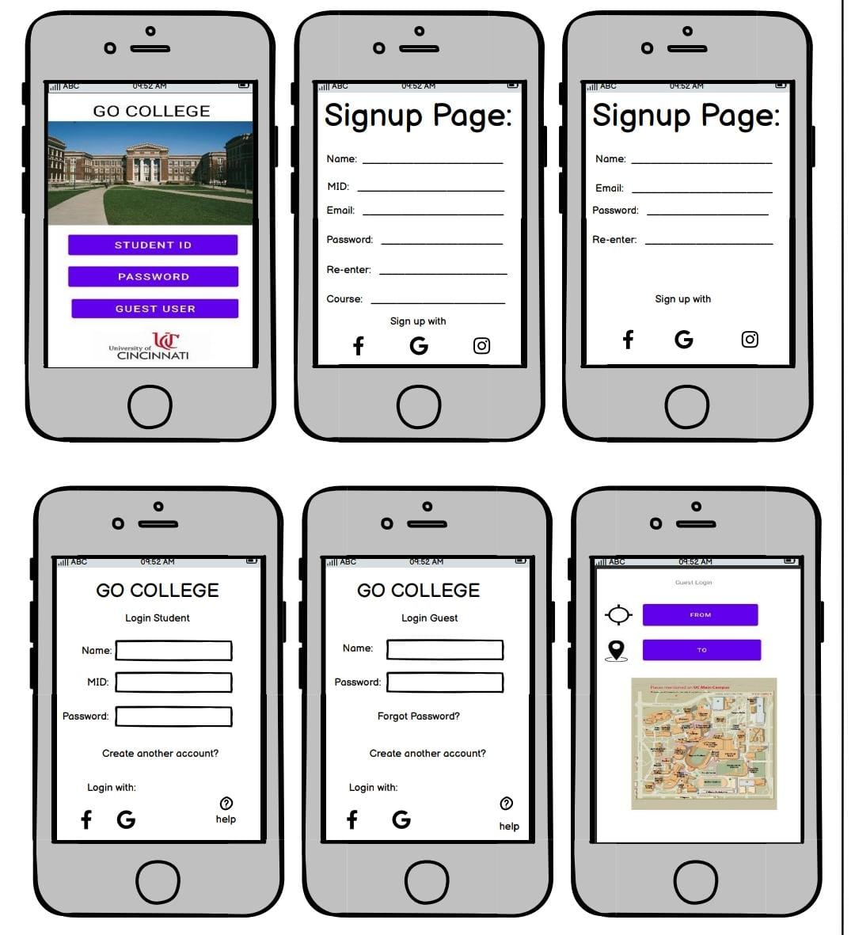
Accessing
Campus Routes
Presentation Title

Slide 10
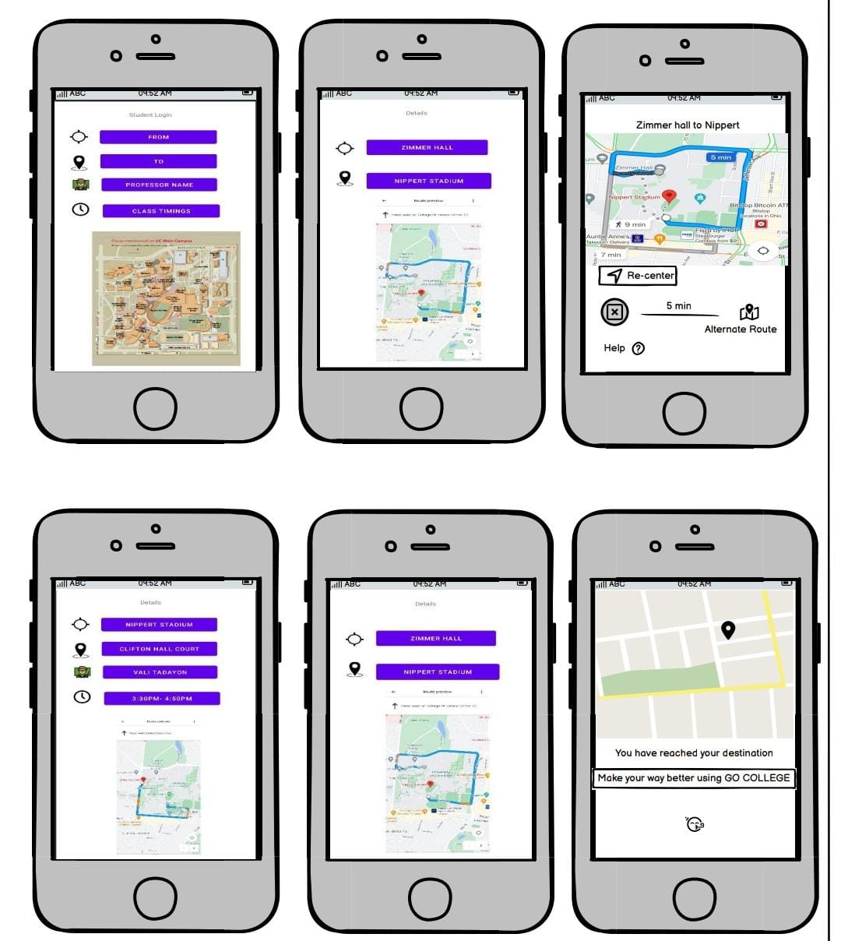
Accessing Campus Routes

Slide 11

Lessons Learned
Communication Skills
Information Gathering
Teamwork
Time Management
Human Machine Interaction

Slide 12

Overall Experience
This project and the class have been an amazing experience from beginning to end. It had imparted knowledge on us in multiple ways.
This project has taught us how to work together, develop creative and practical solutions to clients' problems, present information effectively, and gather data through surveys and interviews.
Our project was completed in phases, including problem identification, information gathering about the problem's effects, effective solution design, solution deployment, and solution review and maintenance.

Slide 13

Summary
Overall, this project was a terrific experience for us. To finish our project, we went through the following five stages: problem definition, impact analysis, arranging our solution, application, and progress monitoring. This project taught us how to fulfill and meet client's expectation.

Slide 14


